Slide 1
__ __ ______ _____ ______ ______ __ __
/\ "-./ \ /\ __ \ /\ __-. /\ ___\ /\ == \ /\ "-.\ \
\ \ \-./\ \ \ \ \/\ \ \ \ \/\ \ \ \ __\ \ \ __< \ \ \-. \
\ \_\ \ \_\ \ \_____\ \ \____- \ \_____\ \ \_\ \_\ \ \_\\"\_\
\/_/ \/_/ \/_____/ \/____/ \/_____/ \/_/ /_/ \/_/ \/_/
______ ______ __ __ ______ __ __ ______ __ __ __ ______
/\ ___\ /\ __ \ /\ "-./ \ /\ == \ /\ \/\ \ /\__ _\ /\ \ /\ "-.\ \ /\ ___\
\ \ \____ \ \ \/\ \ \ \ \-./\ \ \ \ _-/ \ \ \_\ \ \/_/\ \/ \ \ \ \ \ \-. \ \ \ \__ \
\ \_____\ \ \_____\ \ \_\ \ \_\ \ \_\ \ \_____\ \ \_\ \ \_\ \ \_\\"\_\ \ \_____\
\/_____/ \/_____/ \/_/ \/_/ \/_/ \/_____/ \/_/ \/_/ \/_/ \/_/ \/_____/
______ ______ ______
/\ ___\ /\ __ \ /\ == \
\ \ __\ \ \ \/\ \ \ \ __<
\ \_\ \ \_____\ \ \_\ \_\
\/_/ \/_____/ \/_/ /_/
______ __ ______ __ ______ ______ __ ______ ______ ______
/\ == \ /\ \ /\ __ \ /\ \ /\ __ \ /\ ___\ /\ \ /\ ___\ /\__ _\ /\ ___\
\ \ __< \ \ \ \ \ \/\ \ \ \ \____ \ \ \/\ \ \ \ \__ \ \ \ \ \ \___ \ \/_/\ \/ \ \___ \
\ \_____\ \ \_\ \ \_____\ \ \_____\ \ \_____\ \ \_____\ \ \_\ \/\_____\ \ \_\ \/\_____\
\/_____/ \/_/ \/_____/ \/_____/ \/_____/ \/_____/ \/_/ \/_____/ \/_/ \/_____/
_ ___ _ _
/\/\ ___ __| | ___ _ __ _ __ / __\___ _ __ ___ _ __ _ _| |_(_)_ __ __ _
/ \ / _ \ / _` |/ _ \ '__| '_ \ / / / _ \| '_ ` _ \| '_ \| | | | __| | '_ \ / _` |
/ /\/\ \ (_) | (_| | __/ | | | | | / /___ (_) | | | | | | |_) | |_| | |_| | | | | (_| |
\/ \/\___/ \__,_|\___|_| |_| |_| \____/\___/|_| |_| |_| .__/ \__,_|\__|_|_| |_|\__, |
|_| |___/
__ ___ _ _ _ _
/ _| ___ _ __ / __(_) ___ | | ___ __ _(_)___| |_ ___
| |_ / _ \| '__| /__\// |/ _ \| |/ _ \ / _` | / __| __/ __|
| _| (_) | | / \/ \ | (_) | | (_) | (_| | \__ \ |_\__ \
|_| \___/|_| \_____/_|\___/|_|\___/ \__, |_|___/\__|___/
|___/
A blitz through some useful concepts and tools

Slide 2
Outline
Intro
Underlying concepts
Where’s the mouse?
Looking around
Permissions
Getting around
File commands
File I/O
Redirection
pipelines

Slide 3
Some Conventions
Descriptions
$ command
1Il|iO0oB8
1Il|iO0oB8
#comments

Slide 4
General Guidance
1. Google/Bing/Yahoo are your friends.
Also, don’t forget to read documentation
2. Keep backups of everything you can.
3. Use workflows that are non-destructive.
4. Don’t be afraid to break stuff.

Slide 5

Why linix
Free (libre and usually gratis)
Portable
I write a program, and you can usually run it!
Ubiquitous and universal*
Runs on most modern hardware
One set (or only a few sets) of instructions
Steep learning curve
Enormous dividends!!
Alleviated with gui-based distro

Slide 6
Unix philosophy
Doug McIlroy:
Write programs that do one thing and do it well.
Write programs to work together.
Write programs to handle text streams, because that is a universal interface.
Notes:
Head of Bell Labs Computing Sciences Research Center

Slide 7

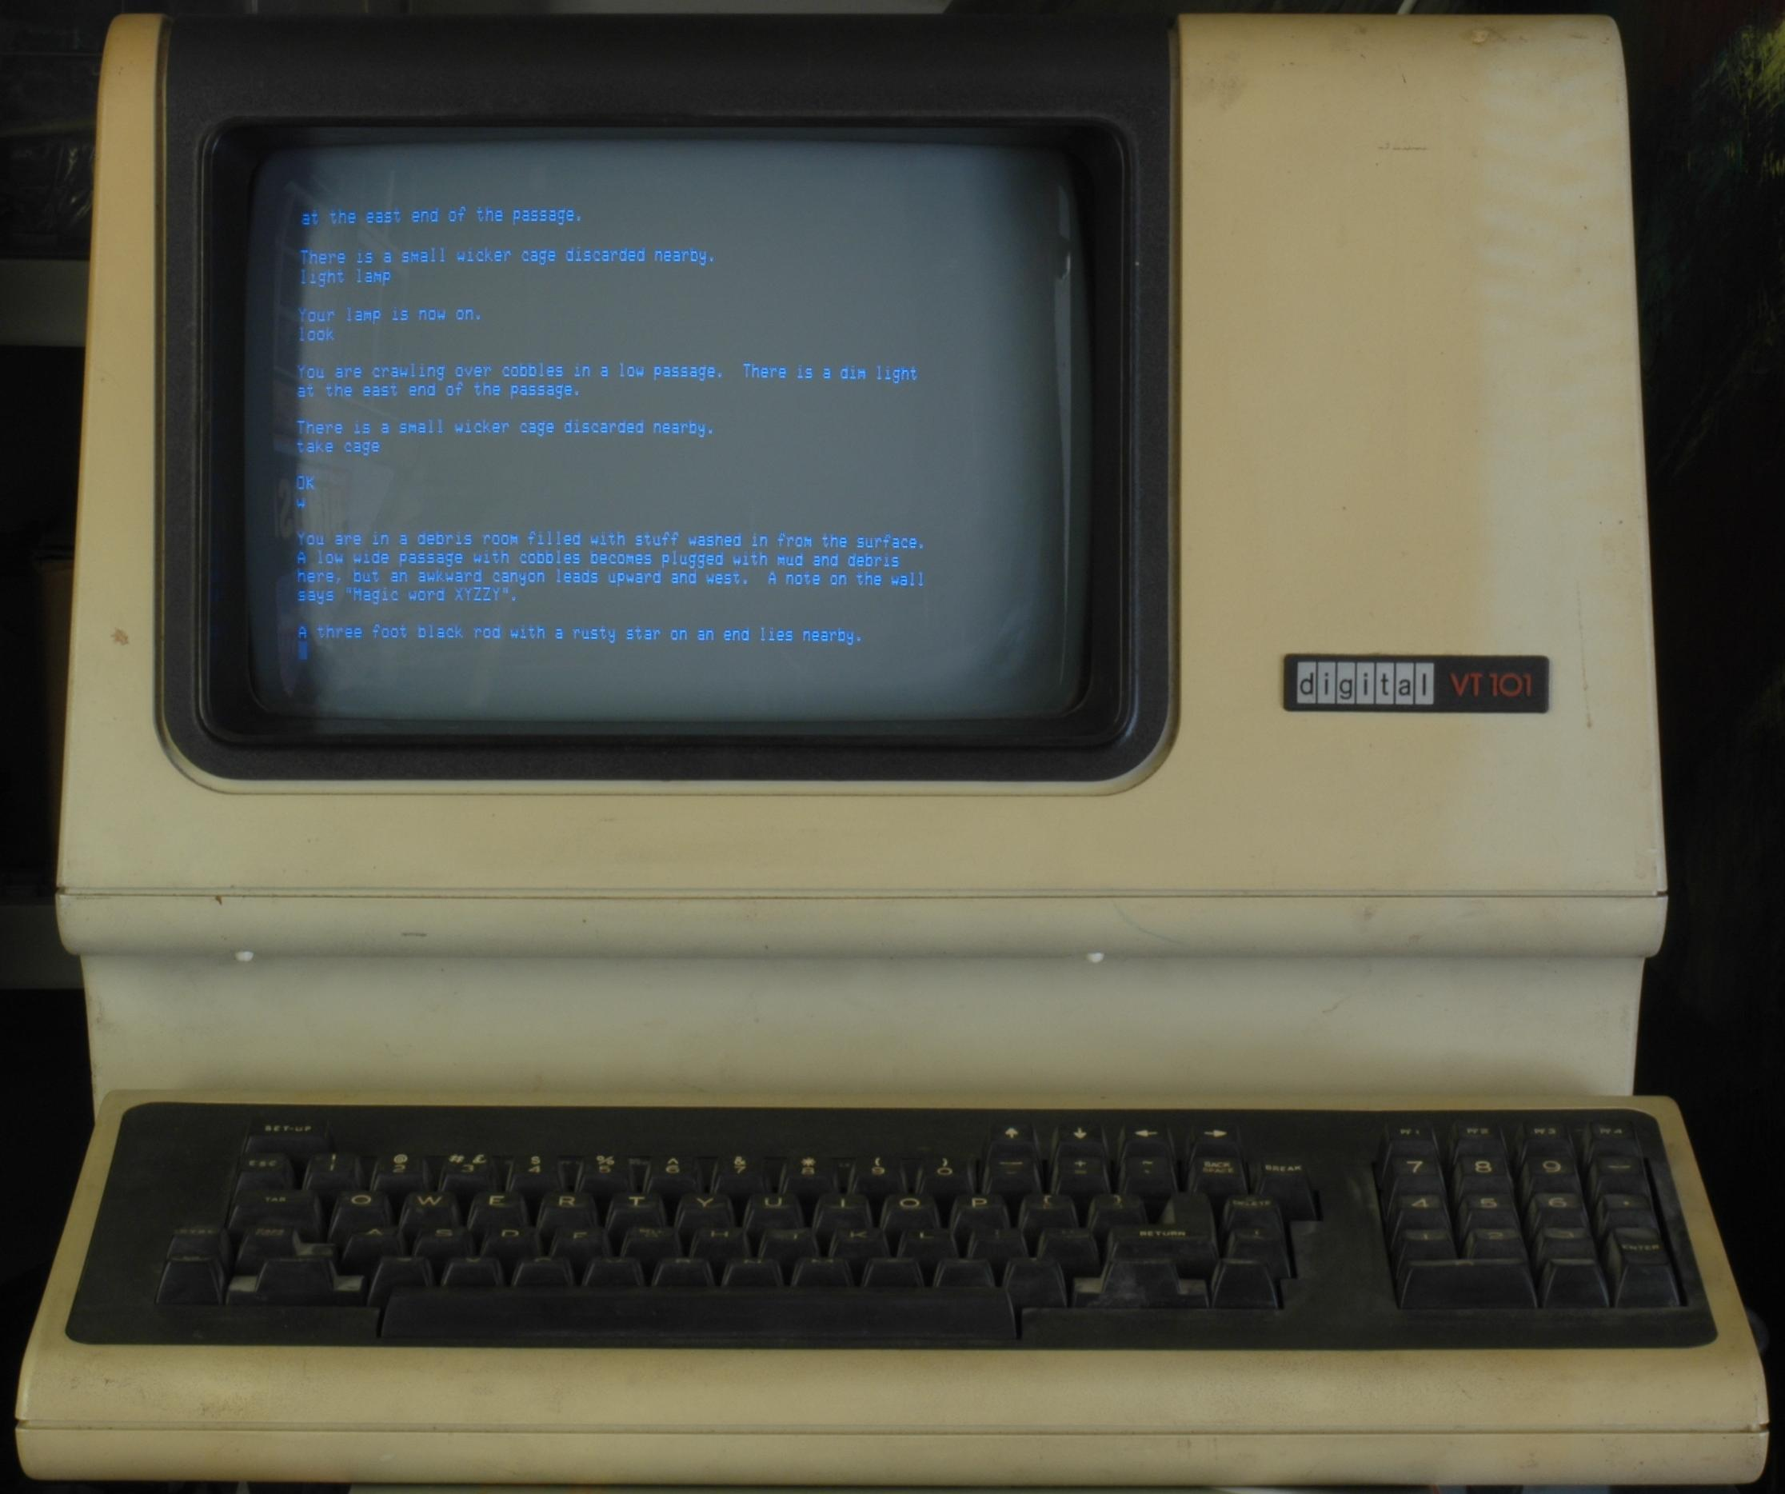
My mouse doesn’t work!
Text commands more flexible & powerful
Like computer shorthand
But you have to know the lingo
Keeping hands on the keyboard saves time (eventually)
Lower system overhead
Easier access and use of remote systems

Slide 8
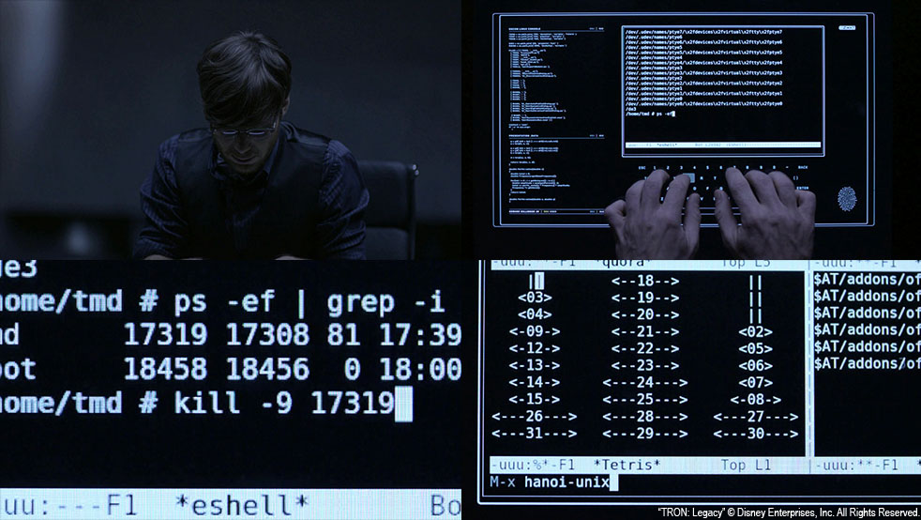
My mouse doesn’t work!
With programs & scripts
Run less risk of insidious mistakes
More reproducible
Saves time if you need to repeat!

Slide 9
One slide about computer hardware
CPU – Central Processing Unit
Usually where your numbers get crunched
Modern computers usually have several
RAM – Random Access Memory
Fast place to work, but volatile and small
Think of this as a small desktop surface
Disk – Hard Drives, Solid State Drives
Stable, long(er) term storage
Think of this as a filing cabinet

Slide 10
a shell
A program that interprets commands
Not an OS
An interface to OS to run commands.
bash: the Bourne Again Shell
Free replacement to Steve Bourne’s Shell
ssh: Secure Shell
cryptographic network protocol for secure data communication

Slide 11
Shell tricks
what was that command?
$ history
last command: up/down arrows
tab completion!
ctrl-r to search command history
ctrl-a/ctrl-e jump to beginning/end of line

Slide 12
Shell tricks
Stop!!!
ctrl-c for break or interrupt
We’re done here
ctrl-d for end of transmission
I want a real tab character!
ctrl-v to insert literal keypress

Slide 13
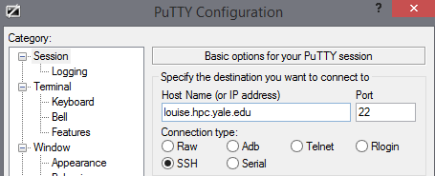
Let’s log in!
Windows:
open putty
Username: de225

Slide 14
Let’s log in!
Macs:
Open terminal.app
$ ssh de225@louise.hpc.yale.edu

Slide 15
Everyone!
[de225@login-0-0 ~]$ ./get_started <name>

Slide 16
Diving in
Type a command, press enter(or return)
Results will be printed to screen*
CASE SENSITIVE
<tab> completion is your friend!
Up/down arrows are your friends!
[be59@login-0-0 ~]$ echo "HELLO"
HELLO
username
computer name
current directory
command (program)
output
argument(s)

Slide 17
Help!
[be59@login-0-0 ~]$ man echo
ECHO(1) User Commands ECHO(1)
NAME
echo - display a line of text
SYNOPSIS
echo [SHORT-OPTION]... [STRING]...
echo LONG-OPTION
DESCRIPTION
Echo the STRING(s) to standard output.
-n do not output the trailing newline

Slide 18
Getting Around
Where am I?
[be59@login-0-0 ~]$ pwd
/home/be59
What’s here?
[be59@login-0-0 ~]$ ls
bin bio ddRAD de225 Jtown lins_folder local_ompi proj ref runFastQC scratch tmp

Slide 19
ls
[be59@login-0-0 ~]$ ls -lah
total 1.2M
drwxr-xr-x 23 be59 caccone 58K Oct 29 23:07 .
drwxr-xr-x 64 root root 0 Oct 29 22:12 ..
-rw------- 1 be59 caccone 33K Oct 23 16:25 .bash_history
-rw-r--r-- 1 be59 caccone 33 Jan 21 2009 .bash_logout
-rw-r--r-- 1 be59 caccone 176 Jan 21 2009 .bash_profile
-rw-r--r-- 1 be59 caccone 1.3K Oct 2 11:17 .bashrc
-rw-r--r-- 1 be59 caccone 1.3K Sep 21 10:13 .bashrc~
drwxr-xr-x 5 be59 caccone 8.0K Sep 23 13:41 bin
drwxr-xr-x 4 be59 caccone 2.0K Jan 9 2013 bio
drwxr-xr-x 4 be59 caccone 2.0K Jun 19 17:10 .config
drwxr-xr-x 3 be59 caccone 2.0K Aug 24 2012 ddRAD
lrwxrwxrwx 1 be59 caccone 11 Dec 13 2011 de225 -> /home/de225
Permissions
everyone
my group
symlink (more on this soon)
me

Slide 20
Getting Around
What kind of file is this?
[be59@login-0-0 ~]$ file bin
bin: directory
[be59@login-0-1 ~]$ file de225
de225: symbolic link to `/home/de225’
[be59@login-0-1 ~]$ file bin/varfilter.py
bin/varfilter.py: a /software/bin/python script text executable

Slide 21
Changing Directories
[be59@login-0-0 ~]$ cd bin
[be59@login-0-0 bin]$
Or
[be59@login-0-0 bin]$ cd /home/be59/scratch/
[be59@login-0-0 scratch]$
directory separator
path

Slide 22
Path shortcuts: there’s no place like ~
. or ./ #this directory
.. or ../ #the directory “above”
~ #your home
~be59 #home directory for user be59
cd ~ #go home
cd #also takes you home
cd - #go to the last directory

Slide 23
Moving & Copying Files
Copy a file
$ cp file.txt new_file.txt
Moving and renaming is the same thing!
$ mv new_file.txt another_new_file
Making a directory
$ mkdir my_new_dir

Slide 24
Viewing Files: cat, head and tail
#spit out the WHOLE file
$ cat file.txt
this is a file!
it contains two lines of text.
$ cat file2.txt
this is another file.

Slide 25
Viewing Files: cat, head and tail
#spit out the first 10 lines of file
$ head file.txt
this is a file!
it contains two lines of text.
#try this!
$ head sample_2.fastq
#first N lines
$ head –n 100 sample4.fastq

Slide 26
Viewing Files: cat, head and tail
#spit out the last 10 lines
#try this!
tail sample_2.fastq
#last N lines
tail –n 50 sample_2.fastq

Slide 27
less is more
#interactive file viewing
$ less file.txt
arrow keys to navigate
-S to stop wrapping long lines
g and G to go to the start/end of file
%50 to go to the middle of the file
q to quit

Slide 28
Files! Wildc*ds!
$ cat file.txt file2.txt
this is a file!
it contains two lines of text.
this is another file.
$ cat file*
this is another file.
this is a file!
it contains two lines of text.

Slide 29
Wildcards everywhere
$ ls *.fa
seq1.fa seq2.fa
$ cat *.fa
>seq1
CGATCGATGCATCGTAGCTAGCTAGCTAGCTGA
>seq2
GTCGACTGCAGTCAGTCAGTCTAGCTAGCAGCTCA

Slide 30

caveat actor
“… the possession of great power necessarily implies great responsibility.”
~Thomas C. Hansard, (1817)
Computers will do exactly what you ask them to!!!
rm –rf ./*
rm –rf ./ *
rm –rf /*
rm –rf *

Slide 31
Finding files
where is the executable?
which grep
/bin/grep
locate (fast & easy), find (slow & hard)
locate grep
find ~be59/MPS_workshop -name \*.fa
what’s this?

Slide 32
The Escape character
often the “\” character
It means ignore what meaning the next character usually has in this context
\t, \n, \*, \., \
\
\
\

Slide 33
File Editing
iLE88Dj. :jD88888Dj:
.LGitE888D.f8GjjjL8888E; .d8888b. 888b 888 888 888
iE :8888Et. .G8888. d88P Y88b 8888b 888 888 888
;i E888, ,8888, 888 888 88888b 888 888 888
D888, :8888: 888 888Y88b 888 888 888
D888, :8888: 888 88888 888 Y88b888 888 888
D888, :8888: 888 888 888 Y88888 888 888
D888, :8888: Y88b d88P 888 Y8888 Y88b. .d88P
888W, :8888: "Y8888P88 888 Y888 "Y88888P"
W88W, :8888:
W88W: :8888: 88888b. 8888b. 88888b. .d88b.
DGGD: :8888: 888 "88b "88b 888 "88b d88""88b
:8888: 888 888 .d888888 888 888 888 888
:W888: 888 888 888 888 888 888 Y88..88P
:8888: 888 888 "Y888888 888 888 "Y88P"
E888i
tW88D Text Editor

Slide 34
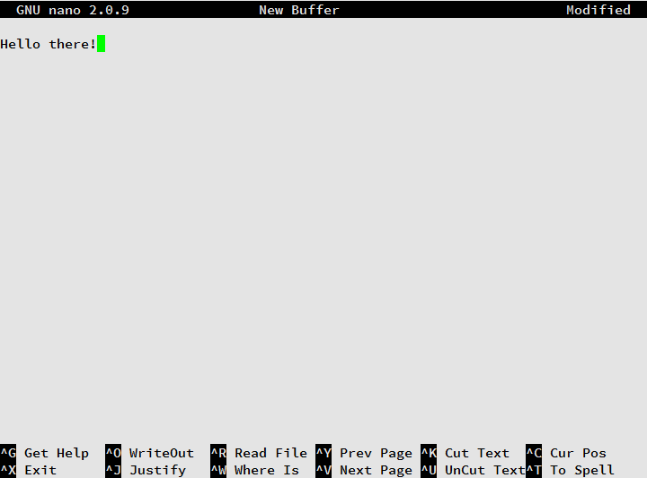
Simple & Easy!!
Notes:
Ctrl-g displays help

Slide 35
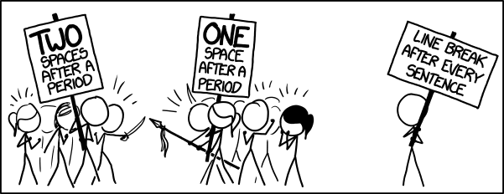
Aside: Line Endings
Different in *nux, older OSX and windows
Can break things in strange ways
$ dos2unix win_file.txt lin_file.txt

Slide 36
g/re/p
Where is the pattern?
Example
Where is the exact motif GGGGCAGG in a fastq
$ grep "GGGGCAGG" sample_2.fastq
$ grep --color "GGGGCAGG" sample_2.fastq
$ grep --color -nr "GGGGCAGG" sample_2.fastq
$ grep --color -m 2 -C 2 -nr "GGGGCAGG" sample_2.fastq
When would this not work how you’d expect?
Hint: line-wrapped sequence?
Notes:
(globally search a regular expression and print)
grep –v
grep -c

Slide 37
awk
Manipulating field-separated data
More advanced features superseded by modern languages like perl/python
Gives you symbols for each column
$number 0-> original line
$1 -> first column
#same as cat:
$ awk '{print}' Chip2comb_001b.sam

Slide 38
awk
Something more interesting
Where did things map?
Chromosome or contig stored in column 3 in sam files
$ awk '{print $3}' Chip2comb_001b.sam
#not quite what I wanted
$ awk '$1 !~ /^@/ {print $3}' Chip2comb_001b.sam
#there!

Slide 39
Redirection
I want to save this output!
Think of them as arrows
> #redirect thing left to file right
>> #append instead of overwriting
< #redirect file right to thing left
Concatenate files
$ cat *.fa > all.fa
Generate a smaller file to play with
$ shuf –n 100 big_file.txt > sample.txt
$ head –n 100 big_file.txt > sample.txt

Slide 40
Piping
Use the output of something as input for the next!
Recall our awk getting contigs mapped
Try this:
$ awk '$1 !~ /^@/ {print $3}' Chip2comb_001b.sam | sort
$ awk '$1 !~ /^@/ {print $3}' Chip2comb_001b.sam | sort | uniq
$ awk '$1 !~ /^@/ {print $3}' Chip2comb_001b.sam | sort | uniq –c
What’s going on here?

Slide 41
Convert a sam back into fastq?
$ awk '!/^@/ {print "@"$1"\n"$10"\n+\n"$11}' sample.sam > sample.fastq
#for bam files
$ samtools view sample.bam | \
awk '!/^@/ {print "@"$1"\n"$10"\n+\n"$11}' > sample.fastq

Slide 42
Questions? Brainstorms?

Slide 43
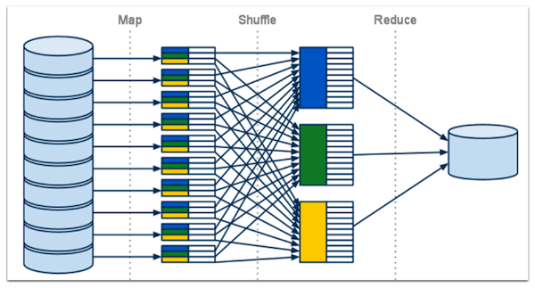
Saving time
Many operations are parallelizeable
Break into chunks then collate back together
Called MapReduce

Slide 44

Do all of the things!
Pleasure ∝ # of CPUs
Give it a list of commands
Give it one command to break into pieces
$ parallel < joblist.txt
#just 2 CPUs at a time
$ parallel –j 2 < joblist.txt
#add column 1 in big_file.txt
$ cat big_file.txt | parallel --pipe awk \'{x+=\$1} END {print x}\' | awk '{y+=$1} END {print y}'

